Slide 1
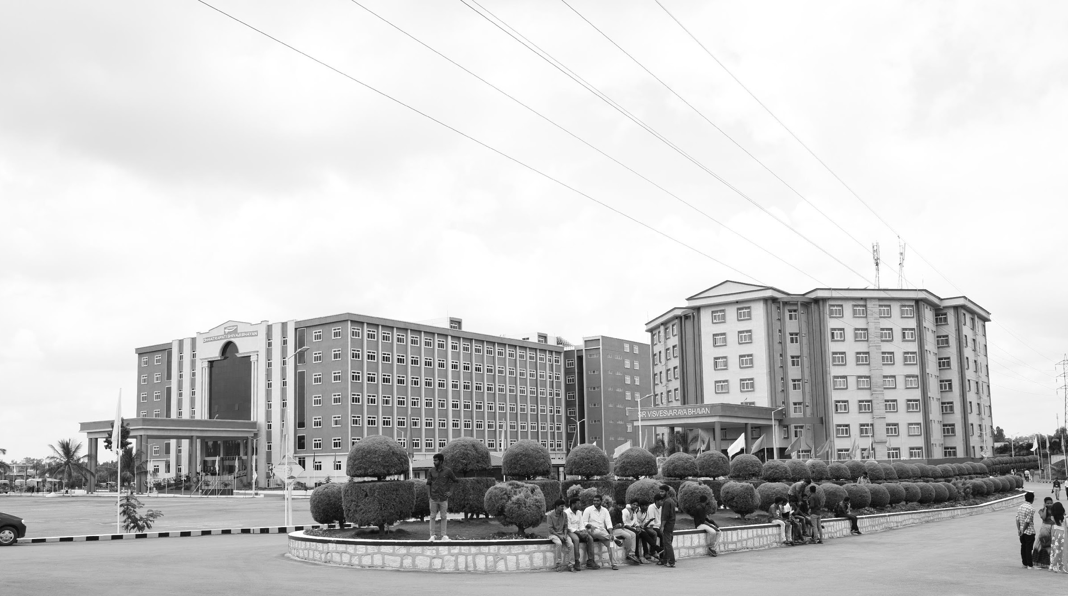

MULTI OBJECT TRACKING ON LOW COST EMBEEDED PLATFORMS
Mid-Review 1/2/3
Major Project
Project ID: A8
AY 2021-25
GITAM (Deemed-to-be) University
Project Team:
109 D. ANIL KUMAR
402 M. RATHNAKAR REDDY
435 N. BADRINATH REDDY
Department of Electrical Electronics and Communication Engineering
Project Mentor:
-> Mr. Venkata Kranti
Project Incharge:
-> Dr. Pankaj Kandhway
www.gitam.edu

Slide 2



Objective and Goals
Objective
To develop a real-time Multi-Object Tracking (MOT) system on a low-embedded platform. The project aims to implement an efficient tracking algorithm after completing the detection phase using YOLO. The system should operate with minimal latency while ensuring high accuracy on resource-constrained hardware. Addressing challenges like occlusion, object re-identification, and ID switching is crucial for reliable tracking. Lightweight tracking techniques will be explored to optimize performance. The system's efficiency will be evaluated based on frame rate, accuracy, and power consumption. Real-world testing will ensure robustness and adaptability. The final goal is to create an optimized and scalable MOT framework suitable for embedded applications.
xxx
Goals
Main Goals
Efficient Object Detection and Tracking on Embedded Platforms
Low-Latency Object Tracking
Robust Object Re-Identification (Re-ID)

Slide 3
Project Plan (Clearly mention milestone for objectives under each reviews)
TASKS | JAN | FEB | MAR | APR
UNDERSTANDING DEEP SORT ALGORITHM
WORKING WITH RASBERRY PI
DOING MULTI TRACKING
DOCUMENTATION

Slide 4
Literature Survey (Improved post minor project)
Key Publications:
1.Real-Time Multi-Object Tracking for Embedded Systems
Authors: John et al., 2022
Overview: This study explores the implementation of a lightweight tracking algorithm optimized for embedded platforms. The authors propose a modified SORT (Simple Online and Realtime Tracking) algorithm to address computational constraints.
2.YOLO-Based Object Tracking on Edge Devices
Authors: Wang et al., 2021
Overview: The paper combines YOLO for object detection with a Kalman filter for tracking. It demonstrates the feasibility of deploying deep learning models on NVIDIA Jetson Nano and Raspberry Pi.
3.Energy-Efficient Multi-Object Tracking for IoT Devices
Authors: Gupta et al., 2020
Overview: Focused on energy-efficient tracking, this paper introduces a hybrid approach combining optical flow and deep features. The study targets IoT platforms powered by ARM Cortex-M processors.
4.Benchmarking Multi-Object Tracking on Embedded Platforms
Authors: Lee et al., 2019
Overview: This paper benchmarks popular multi-object tracking algorithms, such as DeepSORT and Centroid Tracking, on various embedded devices, including Raspberry Pi and Jetson Nano.

Slide 5
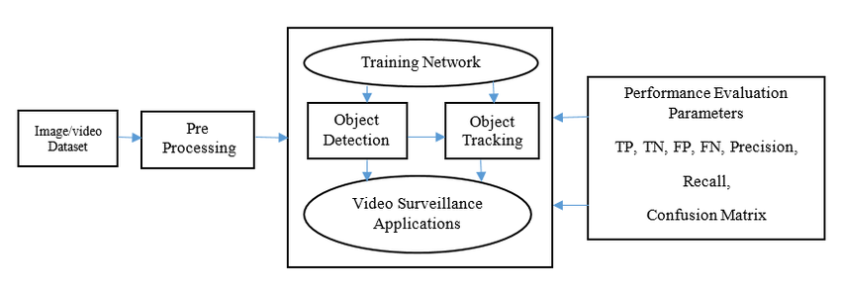
Architecture
l

Slide 6
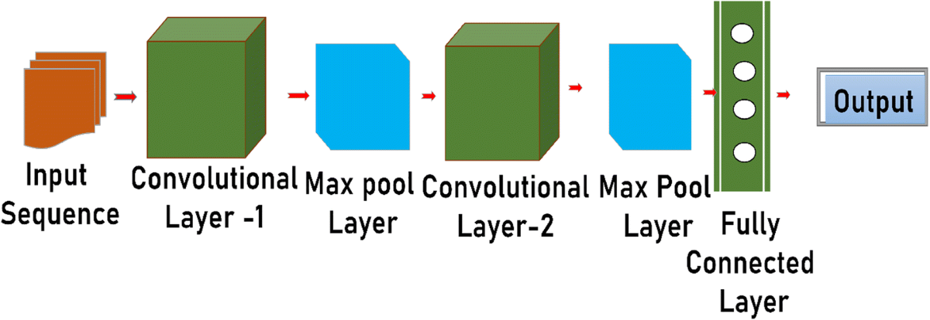

Slide 7
MOT Challenge (Multiple Object Tracking dataset for evaluation).
COCO (Common Objects in Context for object detection).
KITTI (Autonomous driving dataset).
Custom Dataset:
Capturing real-world surveillance footage and annotating manually.
Dataset Preprocessing
Frame Extraction: Extracting frames from videos at fixed intervals.
Annotation: Labeling objects with bounding boxes and assigning IDs.
Dataset Splitting: Train/Test/Validation set division.
Preprocessing
Data Cleaning
Removing redundant frames.
Correcting labeling errors.
image Enhancement
Normalization: Adjusting pixel values for uniformity.
Denoising: Using Gaussian filters or median filters to remove noise.
Data Augmentation
Random rotation, flipping, cropping, and brightness adjustments to make the model robust.

Slide 8
Training Network – How Does Training Work?
Training a deep learning model involves learning patterns from labeled data to make accurate predictions. The training process follows these steps:
1. Data Preparation Input Data: A dataset containing images/videos with labeled objects (bounding boxes + class labels). Preprocessing: Resizing images to fit the model input dimensions. Normalizing pixel values for better learning. Data augmentation (flipping, rotating, blurring) to improve generalization.
2. Feature Extraction The network extracts features from images using a deep convolutional neural network (CNN). Lower layers detect simple edges, colors, and textures. Deeper layers detect complex patterns like object shapes.
3. Training Process The model takes an image as input and predicts bounding boxes and class labels. The predicted outputs are compared with ground-truth labels using a loss function. The model adjusts weights using backpropagation and gradient descent to minimize the loss. This process is repeated for multiple epochs until the model learns accurate feature representations.
4. Loss Functions Used in Training Classification Loss Ensures correct class prediction. Localization Loss Ensures bounding boxes are accurate.
5. Evaluation & Fine-Tuning The trained model is tested on a validation dataset to check performance.

Slide 9
Object Detection – How YOLO Detects Objects
Object detection involves identifying objects in an image or video frame and assigning bounding boxes around them. YOLO (You Only Look Once) is used in our project due to its speed and efficiency in real-time applications.
1. Input Image Processing
Each video frame is divided into a grid, and YOLO scans each grid cell for objects.
The model predicts bounding boxes and class labels for detected objects in a single forward pass.
2. Feature Extraction
A deep Convolutional Neural Network (CNN) extracts features such as edges, textures, and shapes.
These features help in distinguishing different objects within the image.
3. Bounding Box Regression & Classification
YOLO refines the predicted bounding boxes using regression techniques.
A classifier assigns the correct label to each detected object (e.g., person, car, bicycle).
4. Post-Processing Steps
Non-Maximum Suppression (NMS): Removes duplicate bounding boxes to keep only the most confident detection.
Confidence Thresholding: Eliminates low-confidence detections to ensure accuracy.
Why YOLO?
Real-time performance: Processes frames in a single pass, making it faster than two-stage detectors.
High accuracy: Detects multiple objects with high precision.
Optimized for embedded systems: Lightweight models can be deployed on low-power hardware.

Slide 10
Step-by-Step YOLO Processing:
Input Layer (Image Preprocessing)
The input image is resized to a fixed resolution (e.g., 640×640 for YOLOv5).
The pixel values are normalized to improve model efficiency.
Backbone (Feature Extraction with CNN Layers)
A series of Convolutional Layers extract essential features like edges, textures, and object shapes.
Activation Functions (ReLU/Leaky ReLU) help the network learn complex patterns.
Batch Normalization Layers stabilize training and improve convergence.
Neck (Spatial Feature Aggregation)
Uses layers like Feature Pyramid Networks (FPN) and Path Aggregation Networks (PAN) to enhance detection across multiple scales.
Helps detect small and large objects effectively.
Head (Bounding Box Prediction and Classification)
YOLO predicts:
Bounding Box Coordinates (x, y, w, h) – Location and size of detected objects.
Objectness Score – Probability of an object being present in the box.
Class Probabilities – Identifies the object’s category (e.g., car, person, dog).
Post-Processing (NMS & Thresholding)
Non-Maximum Suppression (NMS): Removes duplicate bounding boxes and keeps the most confident detection.
Confidence Thresholding: Filters out low-confidence predictions to retain only meaningful detections.

Slide 11
Object Tracking – How DeepSORT Tracks Objects
Once YOLO detects objects in each frame, DeepSORT (Simple Online and Realtime Tracker) is used to track them across frames, ensuring identity consistency.
1. Initialization of Tracks
When an object first appears, DeepSORT assigns it a unique tracking ID.
This ID remains associated with the object across multiple frames.
2. Motion Prediction (Kalman Filter)
DeepSORT uses a Kalman Filter to predict an object’s next position based on its velocity and acceleration.
If an object moves between frames, the Kalman Filter estimates its new location, ensuring smooth tracking.
3. Object Association (Matching Objects Between Frames)
Objects detected in the current frame are matched with previously tracked objects using:
Intersection over Union (IoU): Measures how much overlap exists between bounding boxes.
Appearance-based Matching: Extracts features from objects and compares them to previously tracked objects.
Hungarian Algorithm: Assigns the best match between detected and previously tracked objects.
4. Handling Occlusions (When Objects Temporarily Disappear)
If an object is temporarily blocked by another object (occluded), the tracker predicts its position instead of deleting it.
When the object reappears, it is matched with its original ID, ensuring identity consistency.
Why DeepSORT?
Improves tracking accuracy by combining motion prediction and appearance-based matching.
Handles occlusions effectively, reducing ID switches when objects disappear and reappear.
Real-time tracking with minimal computational overhead, making it suitable for embedded systems.

Slide 12
Video Surveillance Applications of Multi-Object Tracking (MOT)
Multi-Object Tracking (MOT) plays a crucial role in video surveillance by enhancing real-time monitoring, security, and automated analysis. Some key applications include:
1. Smart Security Systems 🔍
Intruder Detection & Tracking: Continuously monitors multiple individuals and alerts security personnel about suspicious activities.
Restricted Area Monitoring: Ensures only authorized personnel enter specific zones and tracks unauthorized movements.
2.Traffic Surveillance & Management 🚦
Vehicle Tracking: Identifies and follows vehicles across different camera feeds for law enforcement and smart traffic control.
License Plate Recognition: Integrates with ANPR (Automatic Number Plate Recognition) to track stolen or suspicious vehicles.
Traffic Flow Analysis: Helps optimize traffic light control and detect congestion patterns.
3.Autonomous Surveillance Drones 🚁
Aerial Surveillance: Uses drones with MOT to monitor large areas such as borders, forests, and critical infrastructure.
Disaster Response: Tracks people in flood or earthquake-hit regions for quick rescue operations.

Slide 13
Use Cases & Testing
Use Cases
Surveillance and Security Systems
Traffic Monitoring
Retail Analytics
Industrial Automation
Test Cases
Real-Time Tracking
Low Illumination Conditions
Scalability

Slide 14
Contribution
Team Progress and Movement
Understanding deep sort algorithm.
Reading the articles based on multi object tracking.
Getting prepared with the hardware things like Rasberry pi
Individual Contribution
Key contributions: D.Anil Kumar
Handling Software part like Deep sort algorithm
Key contributions: N. Badrinath Reddy
Handling hardware part like working with Rasberry pi
Key contributions: M. Rathnakar Reddy
Documentation part

Slide 15
Conclusion & Future Work
Summary and Conclusion
This project successfully developed a real-time Multi-Object Tracking (MOT) system on a low-embedded platform. The detection phase was implemented using YOLO, and tracking algorithms will further enhance object association across frames. The system aims to achieve high accuracy while maintaining low latency on resource-constrained hardware. Challenges like occlusion and ID switching have been considered, with lightweight techniques explored for optimization. Performance evaluation based on frame rate, accuracy, and power consumption ensures system efficiency. Real-world testing validates the robustness and adaptability of the approach. The project lays a strong foundation for future advancements in embedded MOT systems.
Future Work
Improving Object Re-Identification
Scalability to Handle More Objects

Slide 16
THANK YOU
Have a Great Day !

